Slide 1


Unit 4: Lesson 12 Danger or thrill

Slide 2
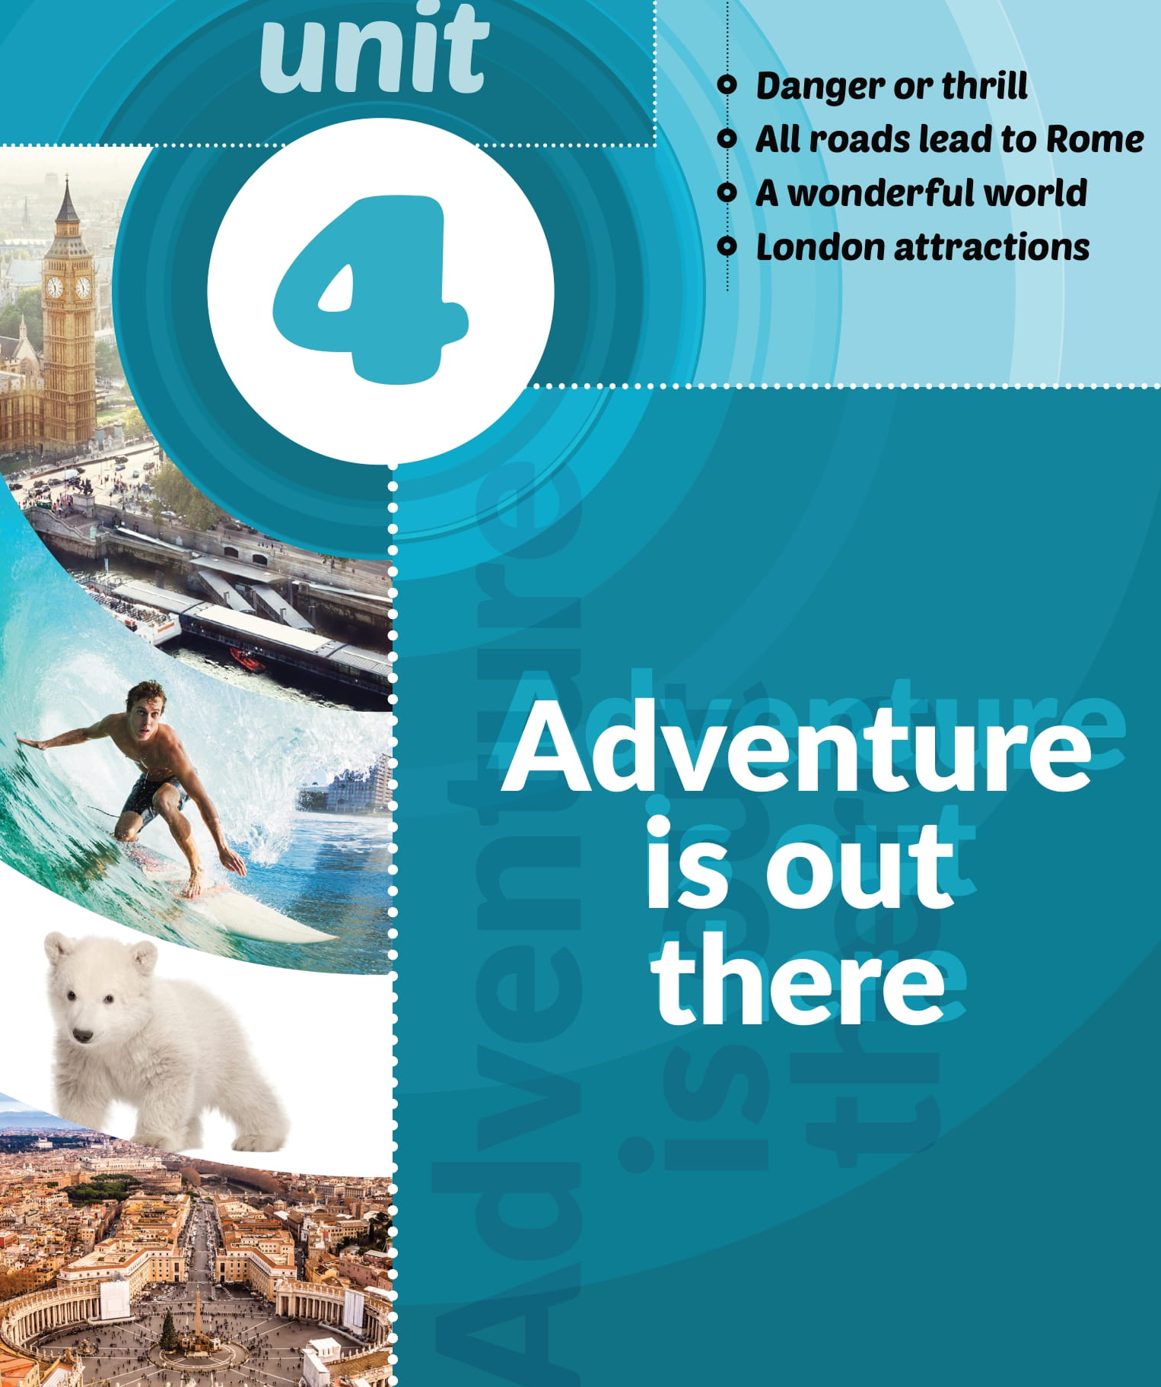
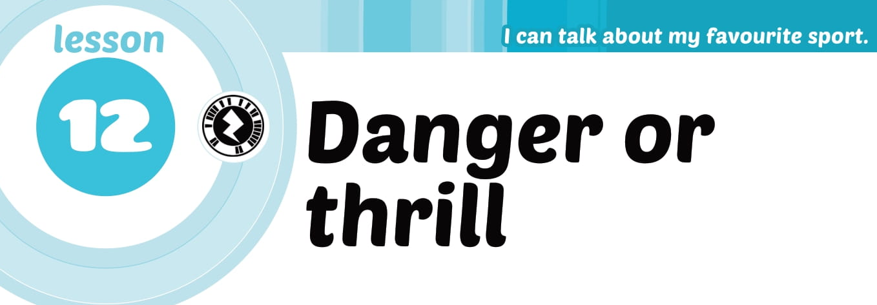

Slide 3
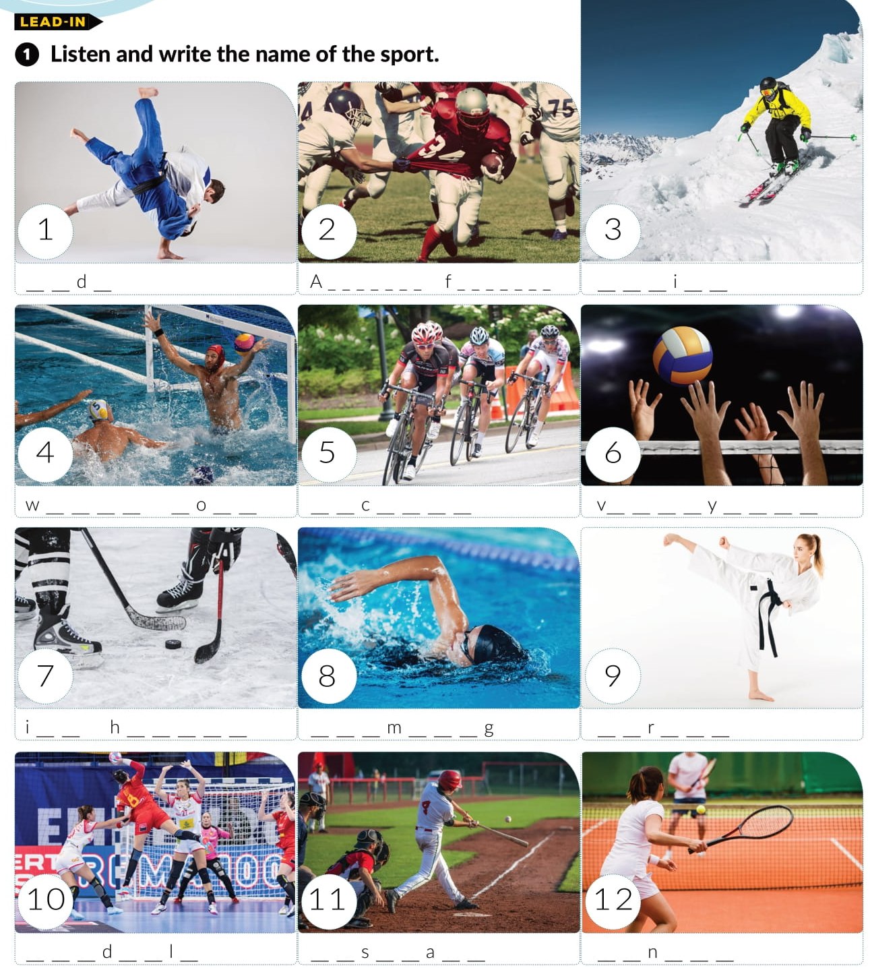

https://www.e-sfera.hr/dodatni-digitalni-sadrzaji/6f523c33-37de-4bac-80ac-14674f2b02b5/
j u o
m e r i c a n o o t b a l l
s k i n g
a t e r p l o
c y l i n g
o l l e b a l l
c e o c k e y p l o
s w i m i n
k a a t e
h a n b a l
b a e b l l
t e n i s

Slide 4

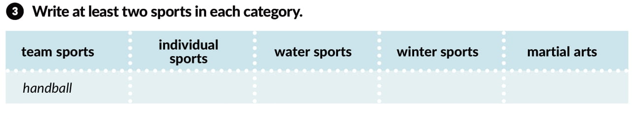
cycling
water polo
skiing
judo
American football
tennis
swimming
ice hockey
karate
volleyball
baseball

Slide 5
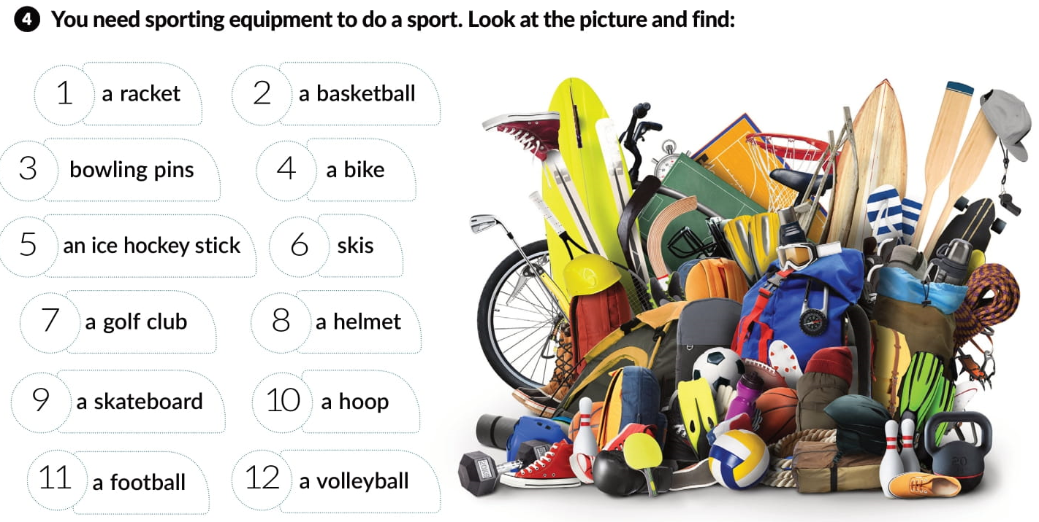
10
6
1
5
7
9
4
11
2
8
3
12

Slide 6
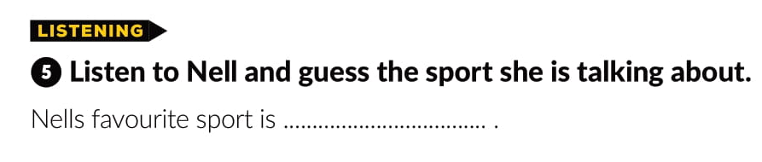
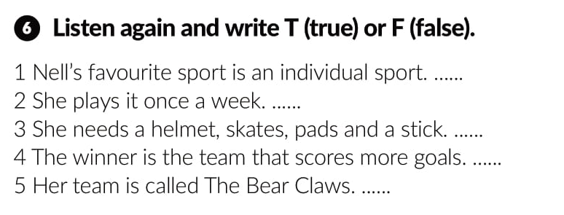
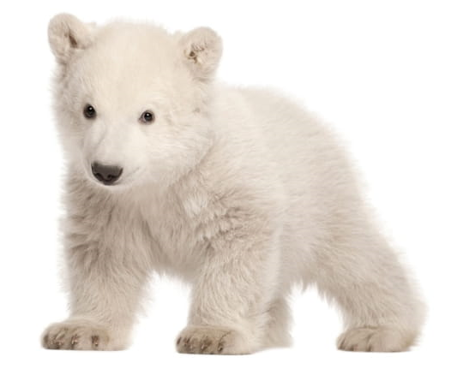
https://www.e-sfera.hr/dodatni-digitalni-sadrzaji/6f523c33-37de-4bac-80ac-14674f2b02b5/assets/audio/track_lesson_12.mp3
hockey
F
F
T
T
F

Slide 7
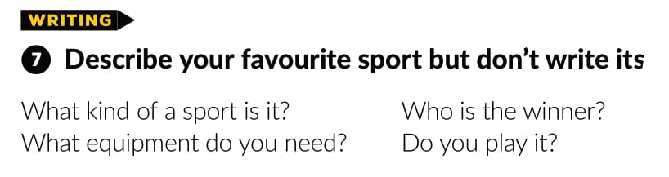
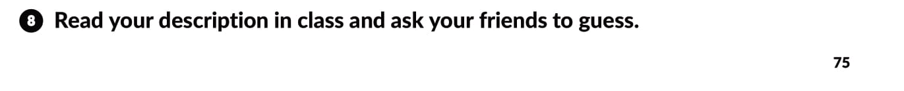

Slide 8
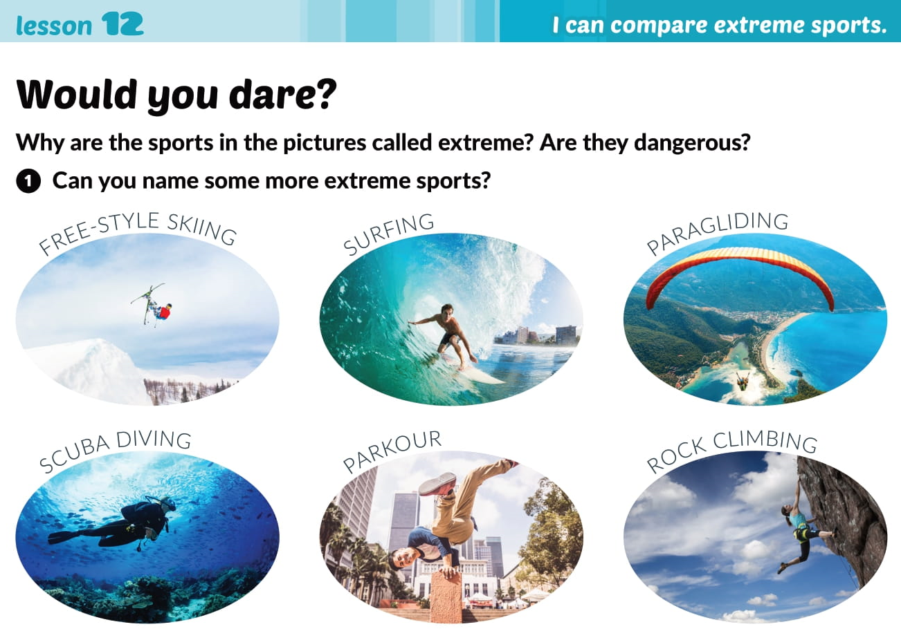

Slide 9
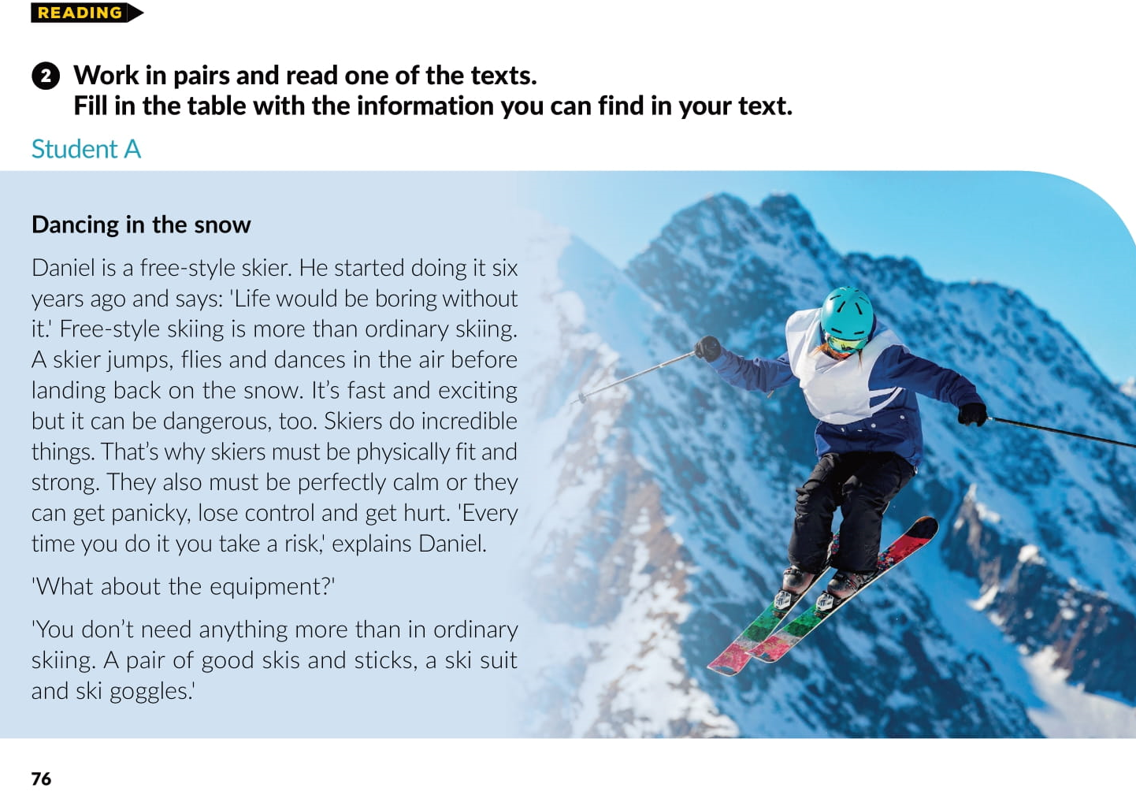

Slide 10
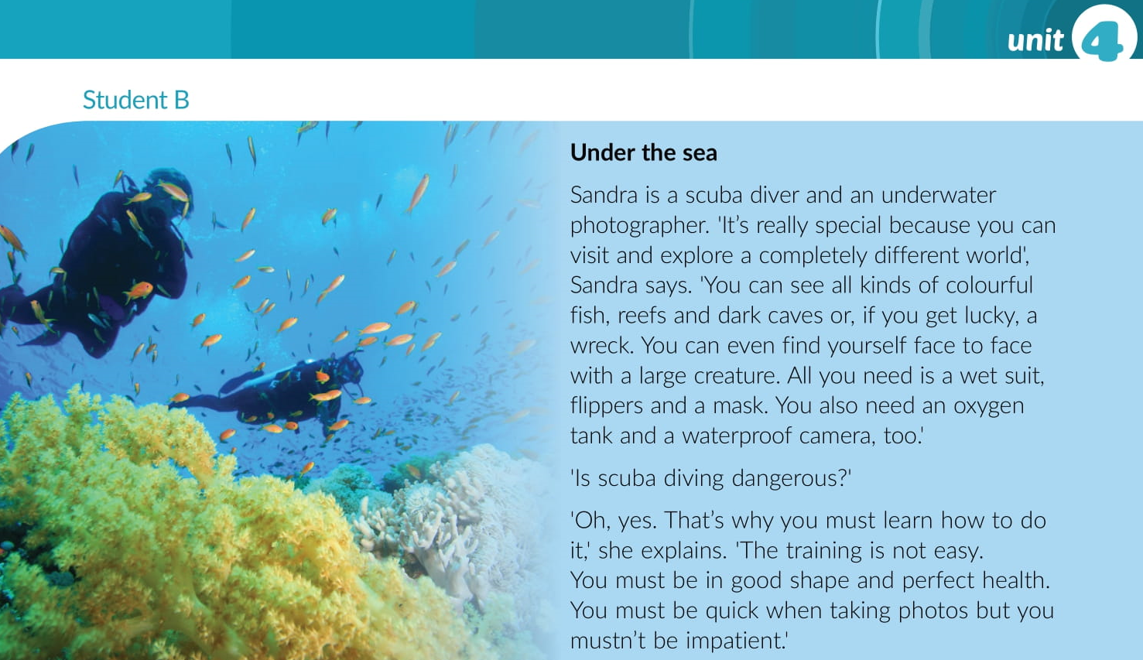

Slide 11
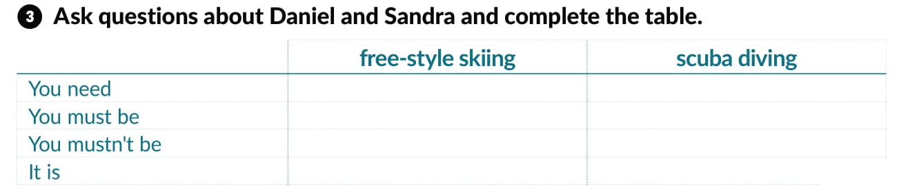
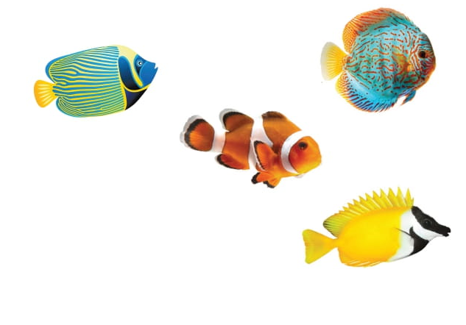
skis and sticks, a ski suit and ski goggles
a wet suit, flippers and a mask
physically fit and strong, and calm
in good shape and perfect health
panicky
impatient
fast and exciting
really special, and dangerous

Slide 12
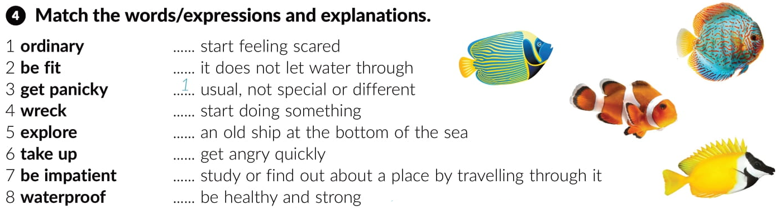
3
8
6
4
7
5
2

Slide 13
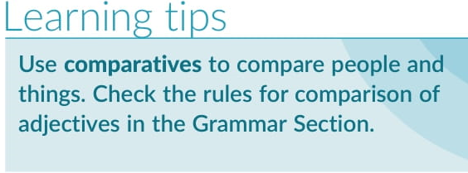
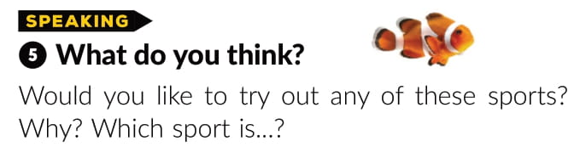
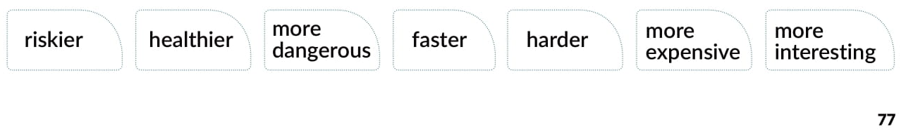

Slide 14
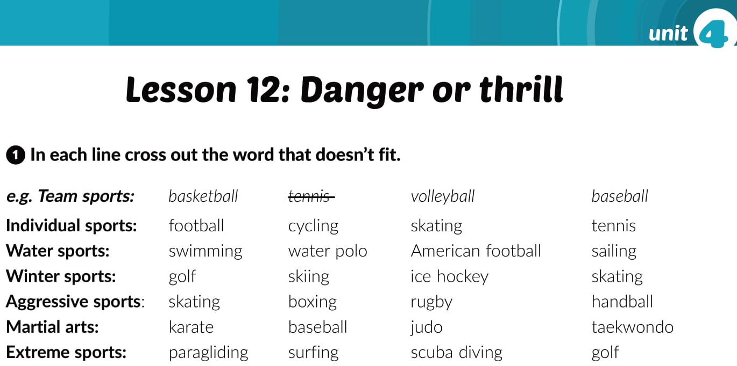
workbook p. 57

Slide 15
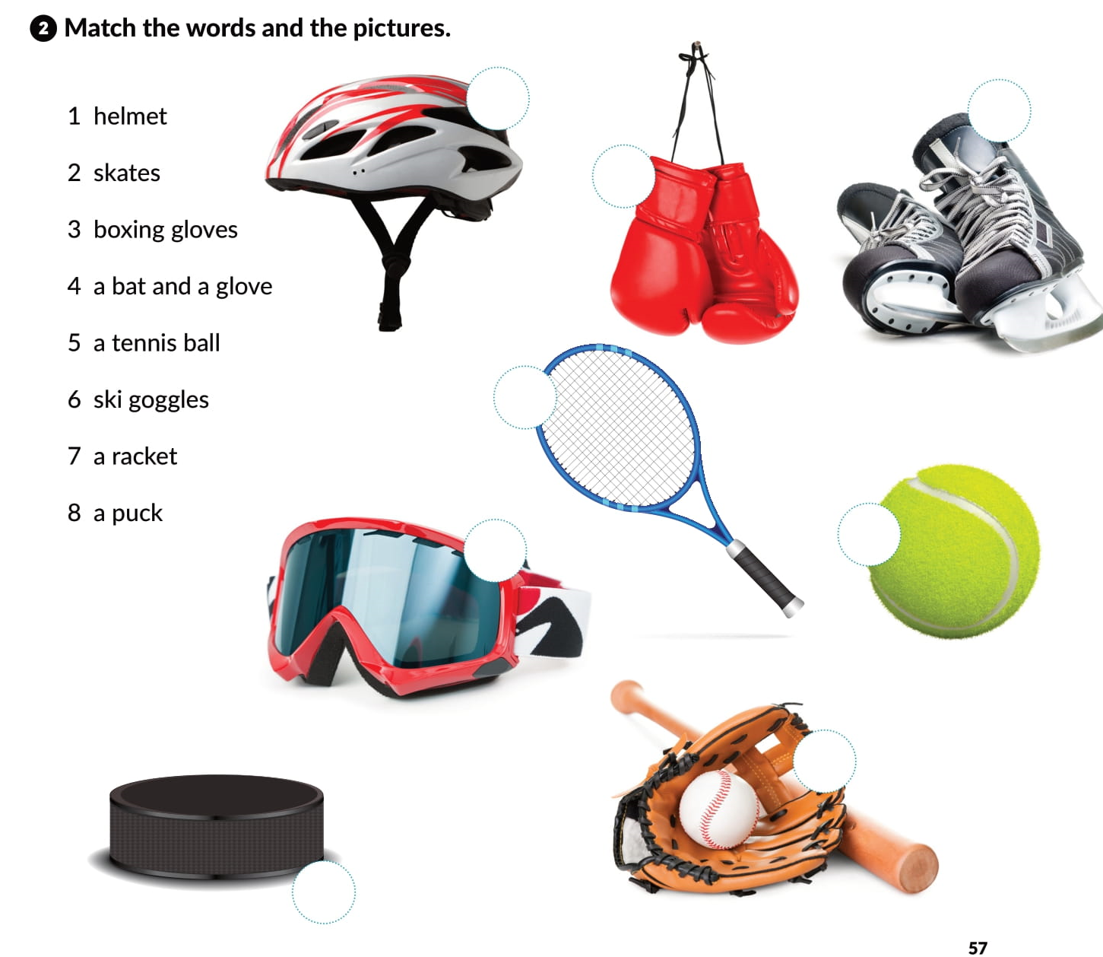
1
2
3
7
5
6
4
8

Slide 16
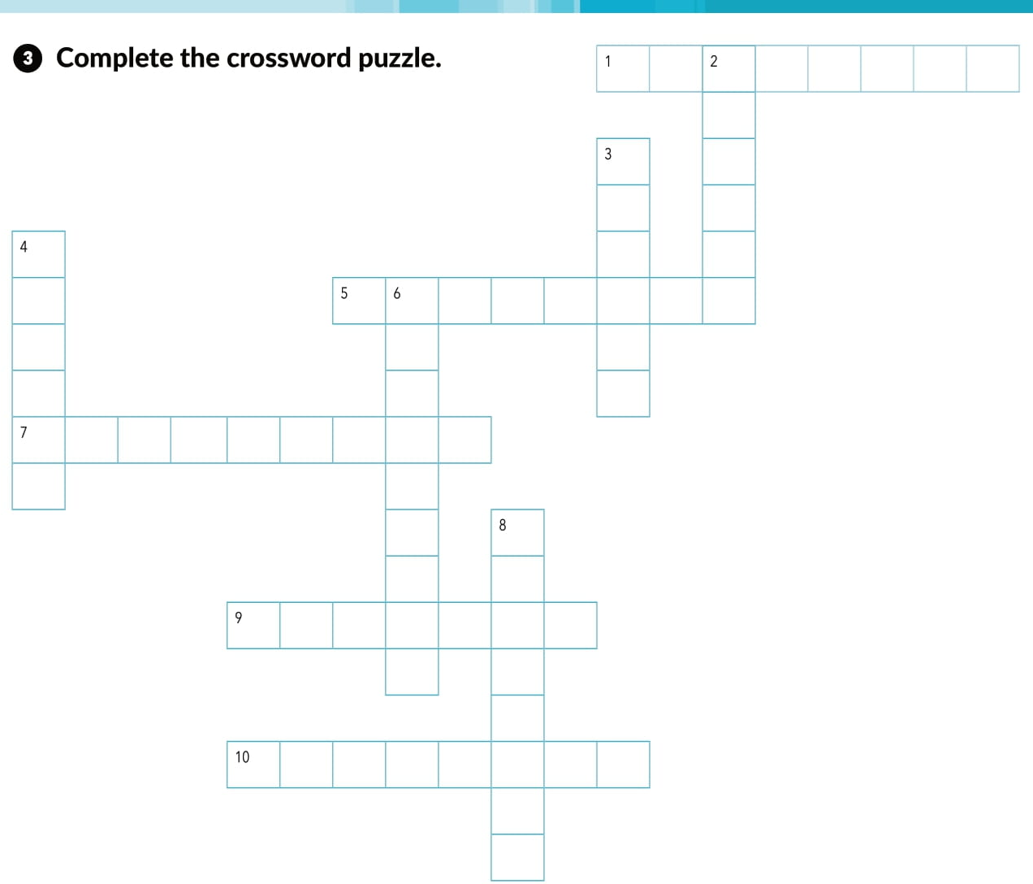
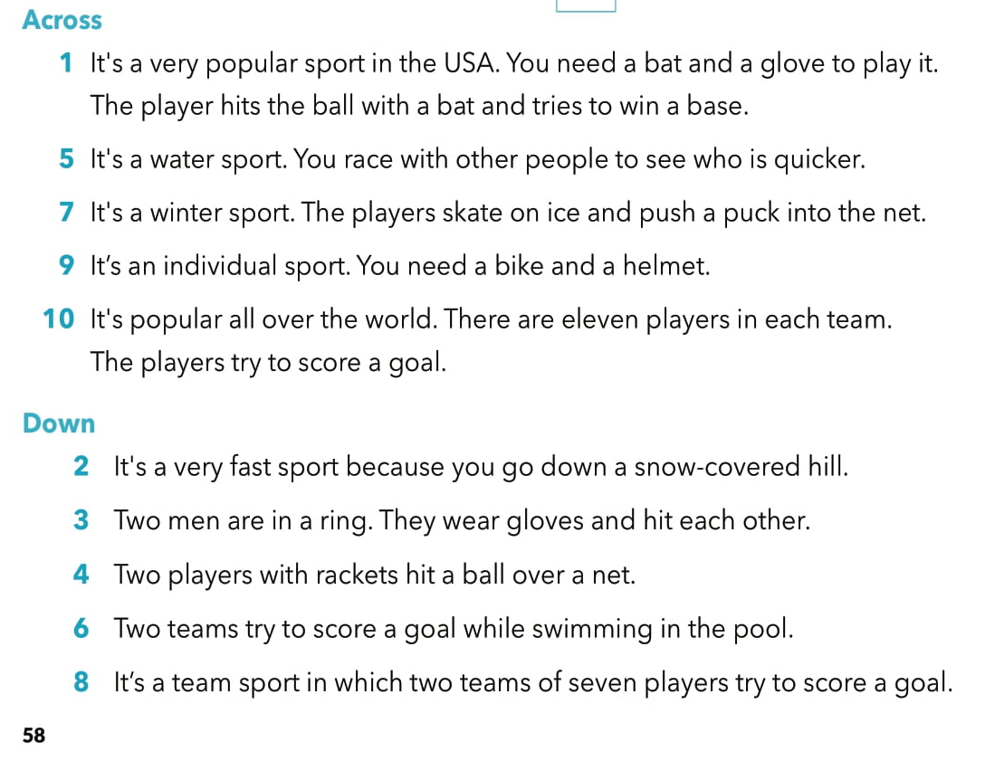
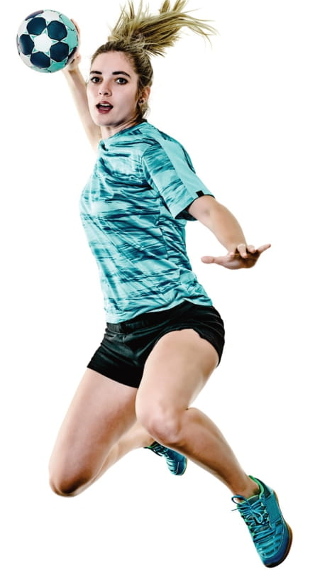
b a s e b a l l
k
i
i
n
g
b
o
x
i
n
g
t
e
n
n
i
s
s w i m m n
a
t
r
p
o
o
c e h o c k e y
h
a
n
d
b
a
l
l
c y c l i g
f o o t b l l

Slide 17
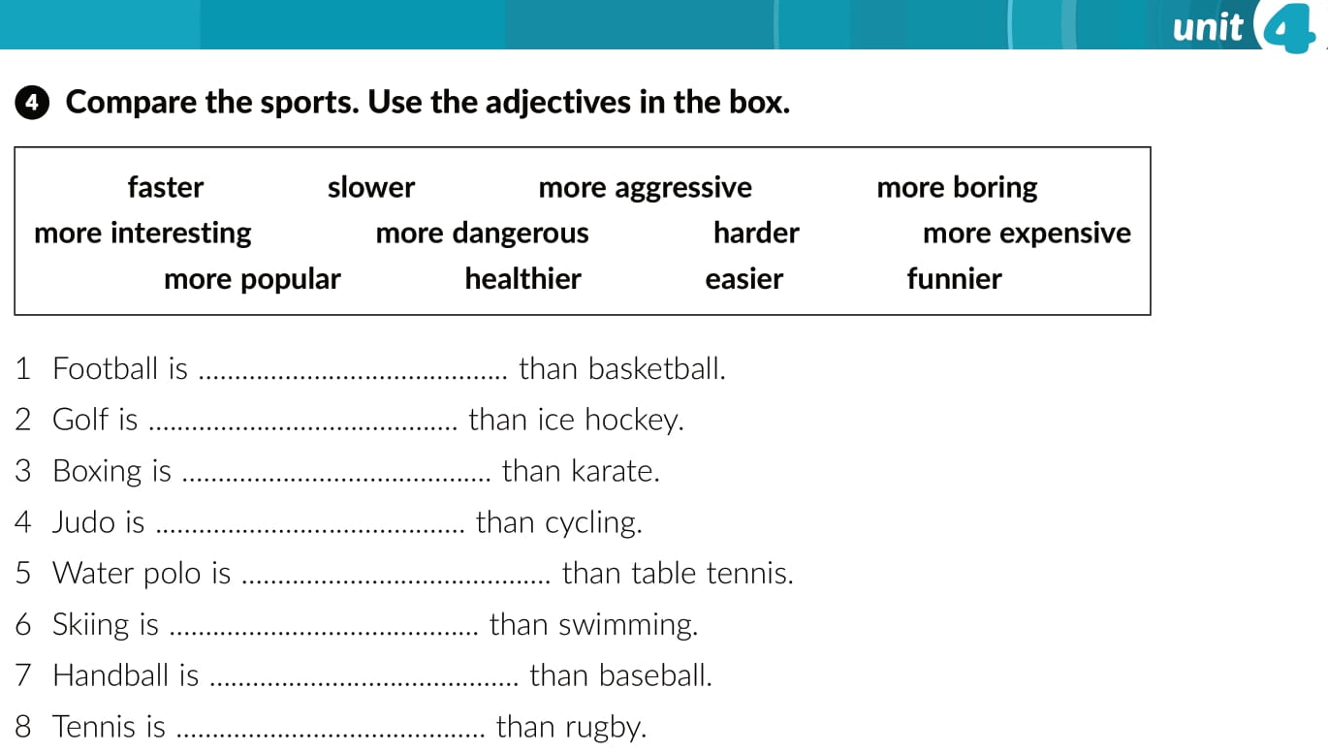
more interesting
more expensive
more dangerous
slower
more boring
faster
funnier
easier

Slide 18
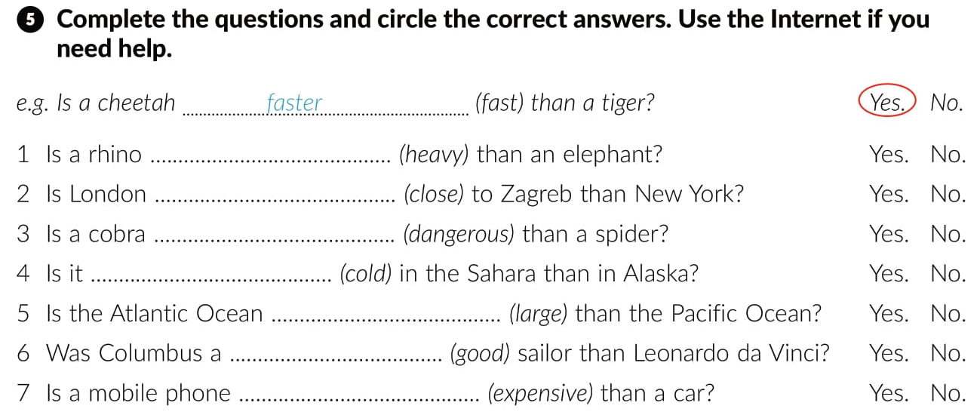
heavier
closer
more dangerous
colder
larger
better
more expensive

Slide 19
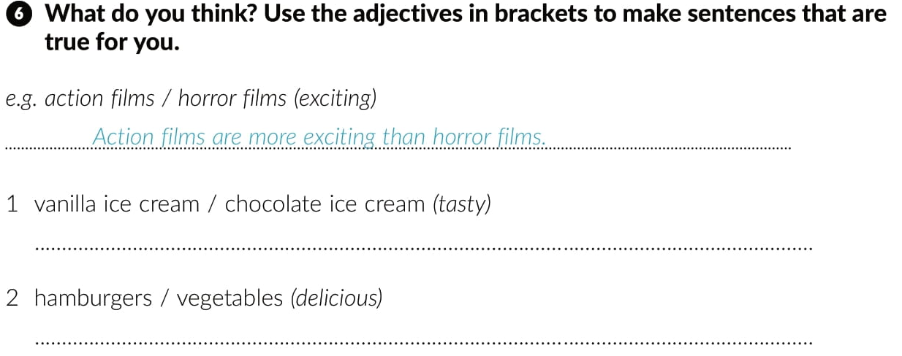
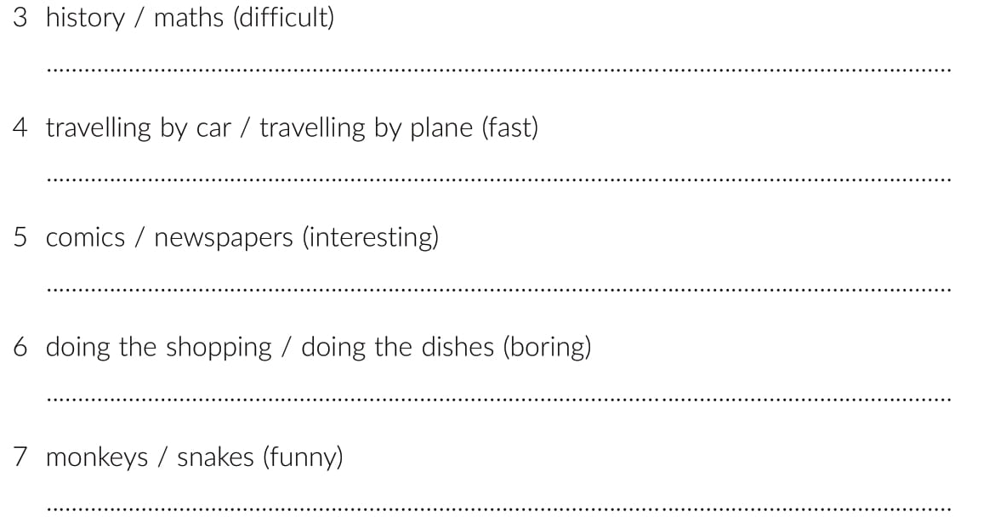
Vanilla ice cream is tastier than ice cream.
Hamburgers are more delicious than vegetables.
History is not more difficult than maths.
Travelling by car is not faster than travelling by plane.
Comics are more interesting than newspapers.
Doing the dishes is more boring than doing the shopping.
Monkeys are funnier than snakes.

Slide 20
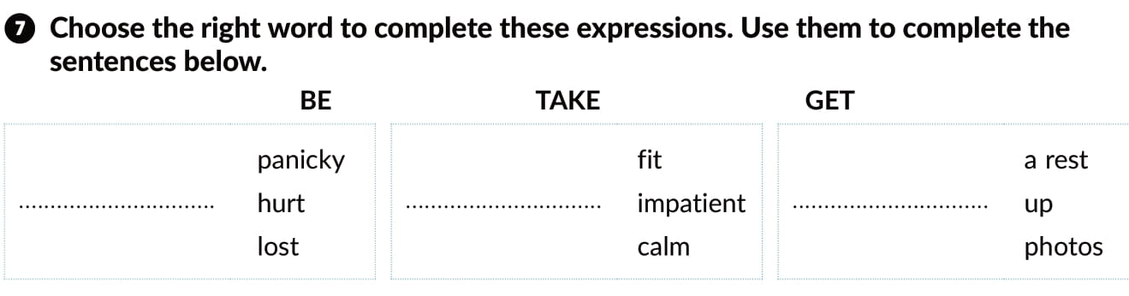
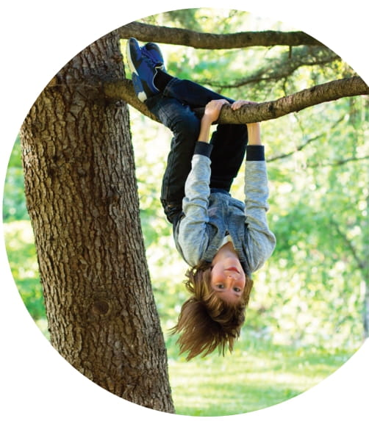
GET
BE
TAKE

Slide 21
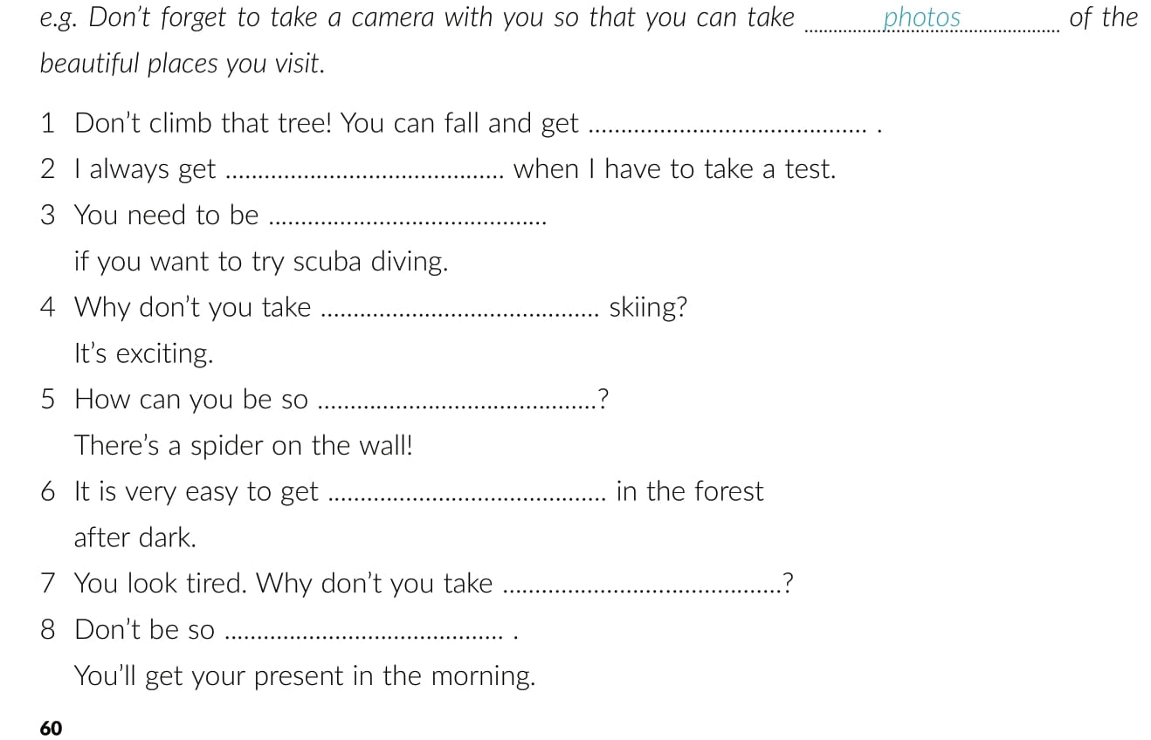
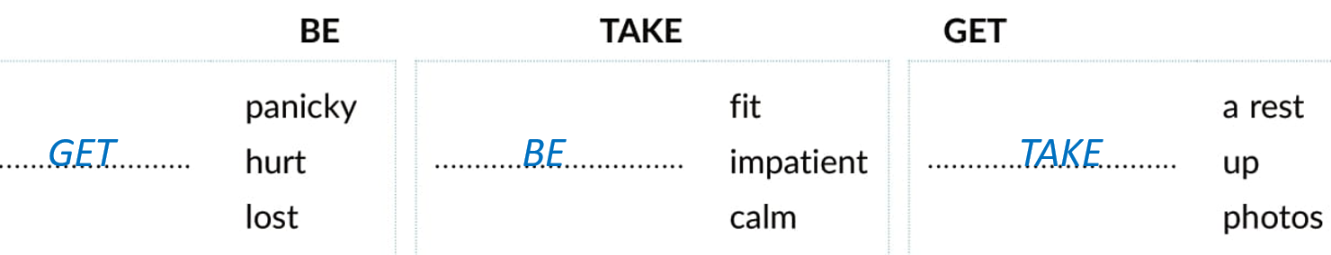
hurt
panicky
fit
take up
calm
lost
a rest
impatient

Slide 22

Otvori sljedeću poveznicu, te odaberi PLAY AND LEARN!
Lesson 12 Danger or thrill | Way to go 3 (e-sfera.hr)

